Slide 1
Module8_FinalProject_TableauItems
File created on: 12/6/2025 4:15:49 PM

Slide 2
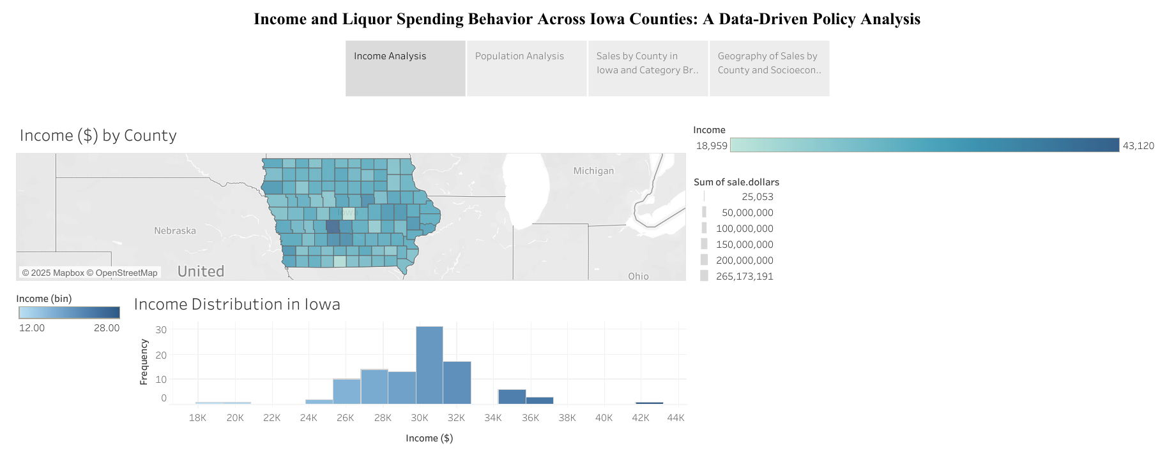

Slide 3
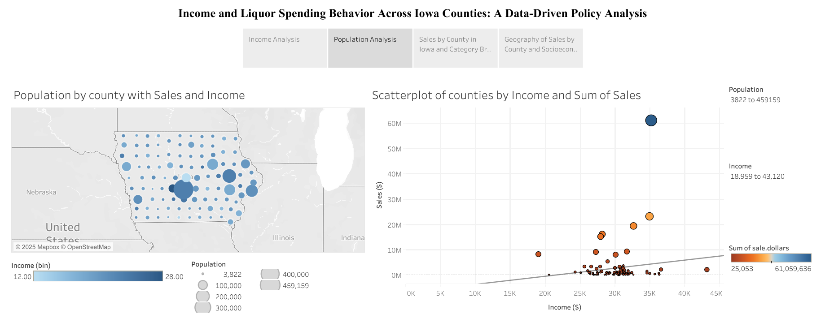

Slide 4
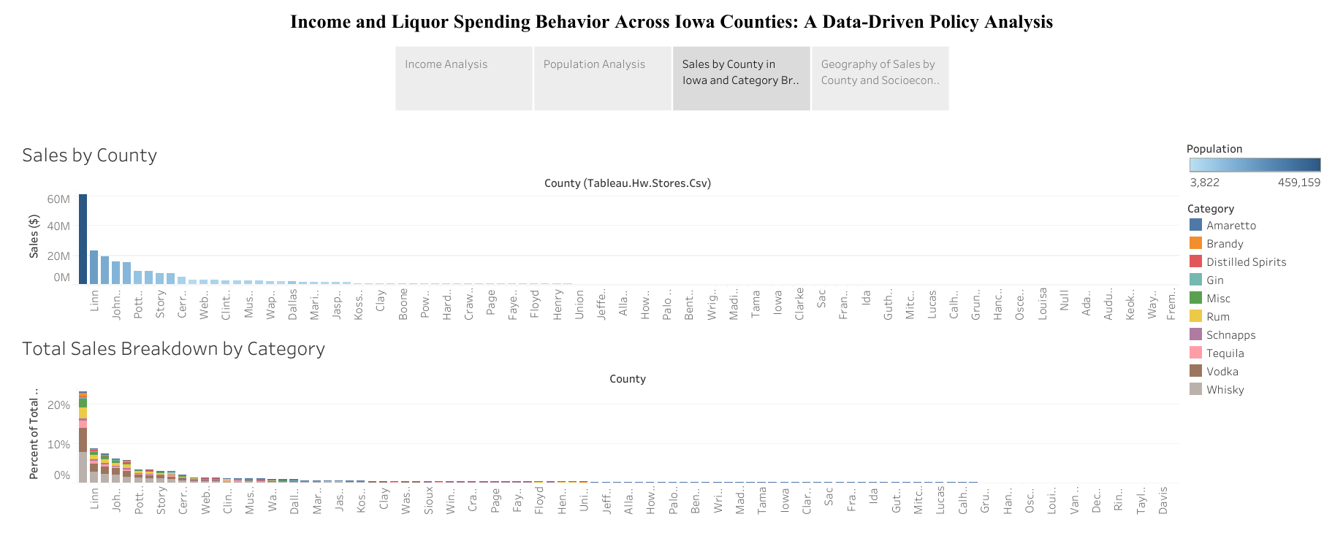

Slide 5
